Slide 1
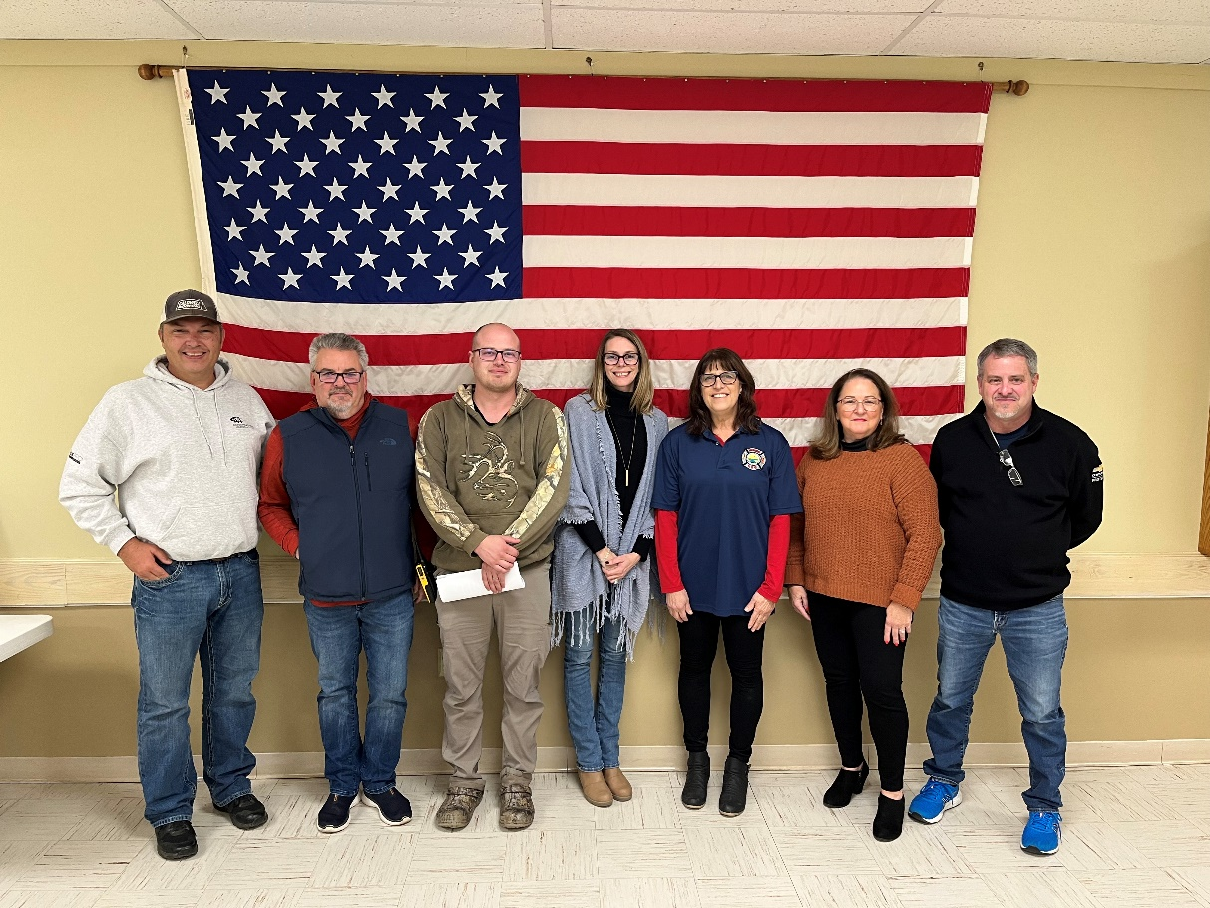
2025 New Saunders Board Members
Left to Right: Chief - Scott Stephenson, Vice President - Brian Miller, President - Matt Long,
Parliamentarian - Kelly Perrow, Treasurer - Sharon Helsens, Secretary - Brenda Miller

